Slide 1
Winning on Appeal
Peter Afrasiabi
One LLP

Slide 2
Kitchen Sink Approach is Generally Bad
“Legal contentions, like the currency, depreciate through over-issue. The mind of an appellate judge is habitually receptive to the suggestion that a lower court committed an error. But receptiveness declines as the number of assigned errors increases. Multiplicity hints at a lack of confidence…. Multiplying assignments of error will dilute and weaken a good case and will not save a bad one.”
--U.S. Supreme Court Justice Robert Jackson--
Notes:
Do not throw out arguments without explaining or developing them. Some, it seems most, judges will ignore completely undeveloped arguments, while a few may work hours to develop them if they want to. Don’t count on anything.
99% chance this is the court of last resort, so throwing out every argument for the “record” is senseless. Need to on the front end very strategically and cautiously decide which arguments have a realistic chance of winning and develop them.

Slide 3
Why Secure Appellate Counsel?
Different center of gravity to trial courts.
New eyes on record focused through prisms that matter in the appellate realm.
Strategic differences between appellate and trial court approaches.
No need to cede case to a new lawyer, just an extension of the team. No control shift is necessary.
www.onellp.com

Slide 4
When to file the Notice of Appeal and when not to count on the filed one as sufficient
Seems easy. 30/60 days after final appealable judgment/order is entered. FRAP 4, 28 USC 1291 (jurisdiction over all ‘final decisions…”).
The premature NOA. Rule 4(a)(2) has a relation forward provision designed to ripen premature NOA’s into timely ones when the final appealable order/judgment is entered. Seems easy and suggests a cautious lawyer should file even if premature and then just wait until finality and have the NOA ripen.
BUT the ripening provision has been somewhat whittled away so that in factual scenarios that seem safe to rely on 4(a)(2), it is not safe. Result: cautious lawyers filing NOA’s early and relying on 4(a)(2) have lost their client a right of appeal.
www.onellp.com

Slide 5
Rule 4(a)(2)
“A notice of appeal filed after the court announces a decision or order – but before the entry of the judgment or order – is treated as filed on the date of and after the entry.”
History: Supposed to codify doctrine of “pragmatic” or “cumulative” finality that had developed in the circuits to allow premature ones to suffice at the right time.
Policy: Avoid form over substance and avoid unnecessarily prejudice for formalistic issues.

Slide 6
The Supreme Court Strikes Back: Firstier v. Investors Mortg. Co., 498 U.S. 269 (1991)
FACTS: bench ruling granting summary judgment/NOA/judgment entered. Held NOA ripens. The holding and rule of law articulated spawned conflict though because court said that ripening will not occur for premature NOA’s that were clearly directed to interlocutory decision because that would not be “reasonable” and because 4(a)(2) addresses situations where all that remains is a “ministerial” act of entry of judgment.

Slide 7
Examples of when Rule 4(a)(2) ripening has not occurred
Kennedy v. Applause, 90 F.3d 1477 (9th Cir. 1996)
Order granting fees and costs/NOA filed/order specifying amount of fees and costs/no NOA/
Held NOA did not ripen because entry of order specifying amount was not merely a ministerial task since fixing the amount of fees had to be briefed and decided.
Note: party was not even able to challenge the basis for granting fees, which had been disputed and litigated in the first order, even if the challenge to the actual amount was lost.

Slide 8
Examples of when Rule 4(a)(2) ripening has not occurred
In re Jack Raley Constr., Inc., 17 F.3d 291 (9th Cir. 1994)
Order granting summary judgment/NOA filed/proposed order with interest lodged/objections to proposed order filed and briefed/order entered/no new NOA filed.
Held the first order did not require a simple entry of an order, i.e., ministerial, and so appellant improperly confused the first order with a final order. As such, appeal dismissed. Party lost challenge to summary judgment ruling, not just the interest calculation.
Rationale: Court was “unwilling to conclude that the Appellants were lulled into the reasonable but mistaken belief that their [first NOA] was efficacious.”

Slide 9
The Ripening Lesson
Based on history of 4(a)(2) and pragmatic approach, the law should be that premature NOA’s ripen so that people do not get defaulted out of an appeal. Some 9th Cir. panels ignore the Firstier overlay and simply ripen the appeals. But some don’t.
If in doubt file the NOA and file a second one when the case is wrapped up with a final order where the district court is done, even if it seems silly. Better safe that sorry.
Be alert to this issue, on both sides of an appeal.

Slide 10
Tolling for NOA: Be Careful
IF a motion under Rule 50(b) (judgment as a matter of law), 52(b) (amend, make new findings of fact) or 59 (amend judgment/new trial), THEN time to file NOA is tolled. But only 10 days to make these motions
IF a Rule 60(b) motion (fraud, mistake, new evidence), then no tolling on time to file NOA. And no 10 day limit either. Must file new NOA from order on Rule 60 motion.

Slide 11
No Finality, But You Want to Appeal: Other Federal Mechanisms
Rule 54(b) certification
  For non-final orders upon determination that there is no just reason for delay.
Collateral Order Doctrine
  Under Cohen v. Beneficial Indust. Loan Corp., 337 U.S. 541 (1949) (conclusively determine question, resolves important issue separate form merits, effectively unreviewable later).
  EXAMPLE: denial of motion to dismiss on ground of qualified immunity or denial of bail
Non-final yet appealable orders:
  Interlocutory appeals under 28 USC 1292
  EXAMPLE: PI motions, appointment of receivers
1292(b) Certification
  For critical question of law, substantial difference of opinion, advance termination of litigation
Mandamus Review
  Under Bauman v. United States Dist. Ct., 557 F.2d 650, 654-55 (9th Cir. 1977) ((1) availability of other relief, (2) prejudice, (3) error, (4) danger of disregard of rules and (5) important question of law).

Slide 12
Standards of Review
Prism through which appellate court looks at lower court decision.
Spectrum of deference from major deference on fact findings to no deference on legal questions.

Slide 13
Clear Error
Reverse if a definite & firm conviction of error

Slide 14
Question of law
De novo, no deference

Slide 15
Abuse of discretion
Deferential standard for activities entitled to deference.
Must be convinced the lower court made a mistake.

Slide 16
Arbitrary & capricious (admin rulings)
Affirmed if at all rational and reasonable, and reversed if arbitrary or capricious.

Slide 17
Briefing: Standards of Review and Prejudicial Error
As always, state the proper standard of review. But understand what it means exactly.
  ADVICE: That is, relate the SOR to the argument. Do not simply assert the standard is AOD and then proceed to argue why the district court’s decision was simply erroneous.
Common error is to assume that any error of law guarantees reversal. Not so. Prejudice standard applies in civil cases too.
  ADVICE: Understand this, for the Court systemically is predisposed to affirm. Appellants: argue it and understand it. Appellees: Don’t forget about exploiting it.
RELATED ADVICE: Court will affirm on any ground in the record. Appellees often seem to forget this principle and fail to exploit the concept of affirmance on other grounds.

Slide 18
Briefing: Use an “Introduction” Section
(1) it allows you to summarize very succinctly why the court erred (or didn’t), and weave into that thumbnail of your argument your theme;
(2) this gives a proper frame of reference to the reader before reading the following pages about jurisdiction, standard of review, and the statement of the issue, which will otherwise be completely divorced from context. Otherwise all the reader knows is that summary judgment is reviewed de novo, the district court should be reversed and jurisdiction exists;
(3) your planted theme seed will then weave into the facts and statement of issues;
(4) this sets the stage properly for the meat of the brief – the argument section.

Slide 19
Briefing: Choose Issues Wisely, But Choose
Need to on the front end very strategically and cautiously decide which arguments have a realistic chance of winning and develop them.
Do not throw out arguments without explaining or developing them.

Slide 20
What EXACTLY do you want the Court to Hold?
Often briefs are not express about what proposed holding they want, other than winning and explaining why the law supports them. Be ready to answer the question at oral argument.
Imagine you are writing law for 50 million people in several western states--- how should the opinion literally read in answering that question?
Answer it in your brief.
Think about narrow holdings.

Slide 21
Exact Disposition
In the conclusion section of the brief, be very explicit about the exact disposition you want: reversed or reversed and remanded for the trial court to do “X/Y/Z.”
All too often, appellants simply say the “district court should be reversed” and leave it vague as to what happens next exactly.

Slide 22
Briefing: Your Audience in a Federal Appeal
Your case, while critical to you, is one of several for the Judge, who also has criminal and death penalty cases that weigh heavily on the mind.
Be concise and transparent with your arguments. Do not count upon law clerks or judges to research peripheral issues.
Clarity in your briefs.
www.onellp.com

Slide 23
The Merits Panels: Who and How Chosen
3 Judges, random.
The panel receives its cases for a given calendar 8-12 weeks before oral argument is scheduled. Sometimes as little as 6.
ADVICE: When the case calendar comes out, look to see if your case has been grouped with other similar cases. Contact those attorneys to see what the issues are in their cases. There may be overlap or even tangential relationships between issues that may refocus issues for oral argument or apprise you to other concerns court may have for your case based on those cases.

Slide 24
Case Study: One Appeal in the Ninth Circuit
Gutierrez ex rel. v. United States, Ninth Circuit Case No. 07-56708

Slide 25
The Case
The facts
Government appeals.
Fundamental Issue for the Government: too much money
  Framed in complex legal arguments: comparison to other horrible injury cases and ratio of economic to non-economic per Judge Posner economic analysis.

Slide 26
Response Prism
Tools:
  Who was the trial judge?
  Frame case through standard of review
  Policy must be tied to any emotional appeal
  Elevate the issue from the narrow streets the gov’t wanted to fight on to the city view

Slide 27
An “Introduction” is Critical
As appellee, you can instantly frame the other side’s case in new terms
Government is arguing on narrow grounds that the award is too much. In 1st sentence, take that head on and recast it: she’s a lucky recipient. Not!
Big picture issue reformulation for thematic purposes, which is picked up on throughout the brief as a thematic tool.
Notes:
Most appellalte judges we speak to all think intros are critical, even though not spelled out in rules.
It is the way to frame the entire brief they are about to read on terms that you need. Thus, when they read the facts and background, they are already attuned to your prism on the issue and see everything through the light we are shining. Otherwise, the story is unfolded in a vacuum without a good reference point.
Major points and themes addressed here: CJ Stotler/SOR/unfathomable injury/govt about-face tactics

Slide 28
¶ 2 of Introduction: No abstracts – who and what

Slide 29
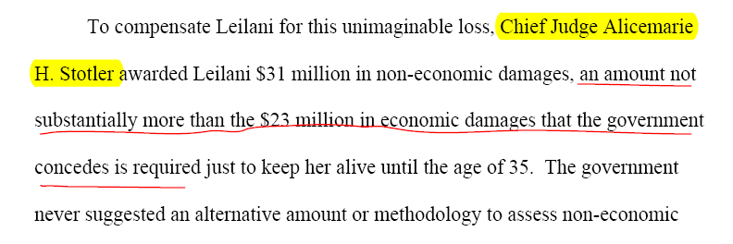
¶ 3 Intro: Judge below did what?
Here, constant reference to the judge in these terms is important.
Diffuse amount immediately

Slide 30
Intro – Framing the Issue
→ Focus on the issue through the standard of review constantly.
→ As they get to the facts, standard of review, procedural history, issue framing, the relevant seeds have all been planted.

Slide 31
Facts
Graphs, charts, pictures (from evidence) can have great value in briefing.
Notes:
Facts are written through the SOR and governeing substantive legal prism.
Loads of facts that are hugely important at trial, but not on appeal. Avoid side-shows, even if they are good.

Slide 32
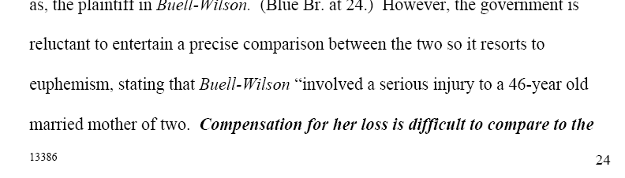
Argument
Destroy the other side’s argument but on our terms, not tit for tat.
Major themes
Notes:
Must define the battle ground bya ddressing their arguments, but not necessarily in the same box or the same order. Reframe the issue and justify affirmance, but certainly respond where necessary.

Slide 33
Signposts
Notes:
First argument: too much absolutely. Govt’s major argument here hinged on 3 9th cir med mal cases. By the time we reframed the issue through the SOR and appropriate comparisons, their entire argument was relegated to a final near footnote section.
Thus, the panel has a major structure from the govt that is demolished by us. Many advocates simply respond tit for tat and explain why those cases are inapposite -> leading with that direct response lends credence to the very cases raised. Go up to a city view level to the real issue, demolish the bedrock of the argument and then as night follows day those cases have been rendered irrelevant and say so with a final note.

Slide 34
Signposts, succinct issue and argument framing
Notes:
Trickier – here second argument was written by Posner, a highly respected law and econ judge. Need to break the argument but reduce any focus on Posner and avoid any unnecessary mudslinging to the opinion. Never referred to Posner by name once.
→ before hitting Posner’s theory head on, find another body of law to reject it for us, so it is not US hitting back at Posner. Found a way to frame it through Cal law.
→ minimize scope of the case by making clear its approach was not mandatory – that was a renegade district judge case.

Slide 35
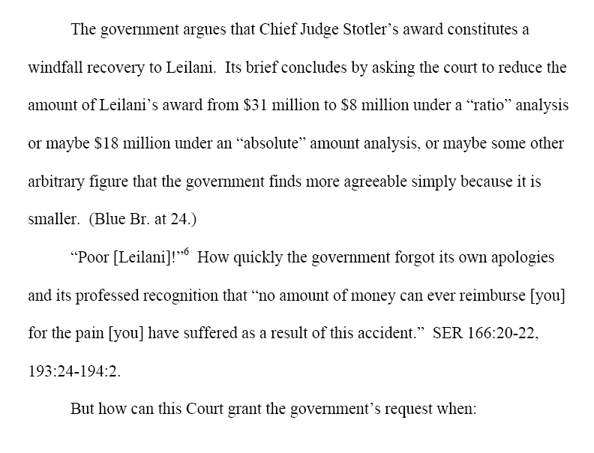
Conclusion: Maintain theme and use tools that may not have been germane legally to the argument but have powerful atmospheric value
Notes:
DeShaney – famous case that jurists know, and the emotional sentiments of that case were not dissimilar so a lot of that emotional punch can be carried through a cite to Justice Blackmun as opposed to our waxing on.

Slide 36
Don’t Oversell
Horrific accident, damaged child. Can be too easy to overplay that hand to the exclusion of the legal argument.
Remember: appellate court makes law for a jurisdiction and is constantly thinking about the implications of a decision for other fact-patterns.

Slide 37
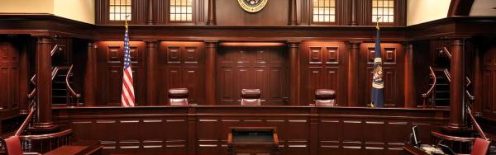
Oral Argument
Three-judge panel (not announced until week before argument)
10-15 minutes of argument per side
Aggressive, detailed questioning

Slide 38
Q and A
Not political speech time.
Not jury argument-emotion time.
You are on a river and go where the river takes you with some control over your boat to make certain maneuver → those are the key points.
Answer directly without evasion. Always.

Slide 39
Effective Arguments
  Grab attention quickly before you are interrupted.
  Be prepared to spend most of your time answering questions.
  Have key points to work in as opportunities arise.
  Have record citations at your fingertips.
  Be ready to discuss cases.
  Be ready for hypotheticals.
  Be ready to discuss the procedural implications of your positions.
  Stay cool under pressure.

Slide 40
Oral Argument - Staying Cool
U.S. v. Black 07-4080, 7th Cir., argued 9/29/10

Slide 41
Disposition - Possible Outcomes
Affirmance for the reasons stated by the trial court
Affirmance on alternative grounds
  In rare cases, issues the trial court didn’t reach
Remand with directions → what directions?
Remand for further trial-court proceedings

Slide 42
Amicus Briefs
Friend of the Court filing, of ancient lineage.
Strategic tool
    Focus court’s attention on your issues as holding broader legal, social, and economic import.
    Can contextualize issues in critical ways.
Example
Define success

Slide 43
Federal Appellate Mediation Program
Settlement opportunity.
Ninth Circuit example.

Slide 44
Pro Bono Appellate Program
Ninth Circuit Pro Bono Program
  Brief writing experience
  Guaranteed oral argument!
  Help the Court

